Slide 1


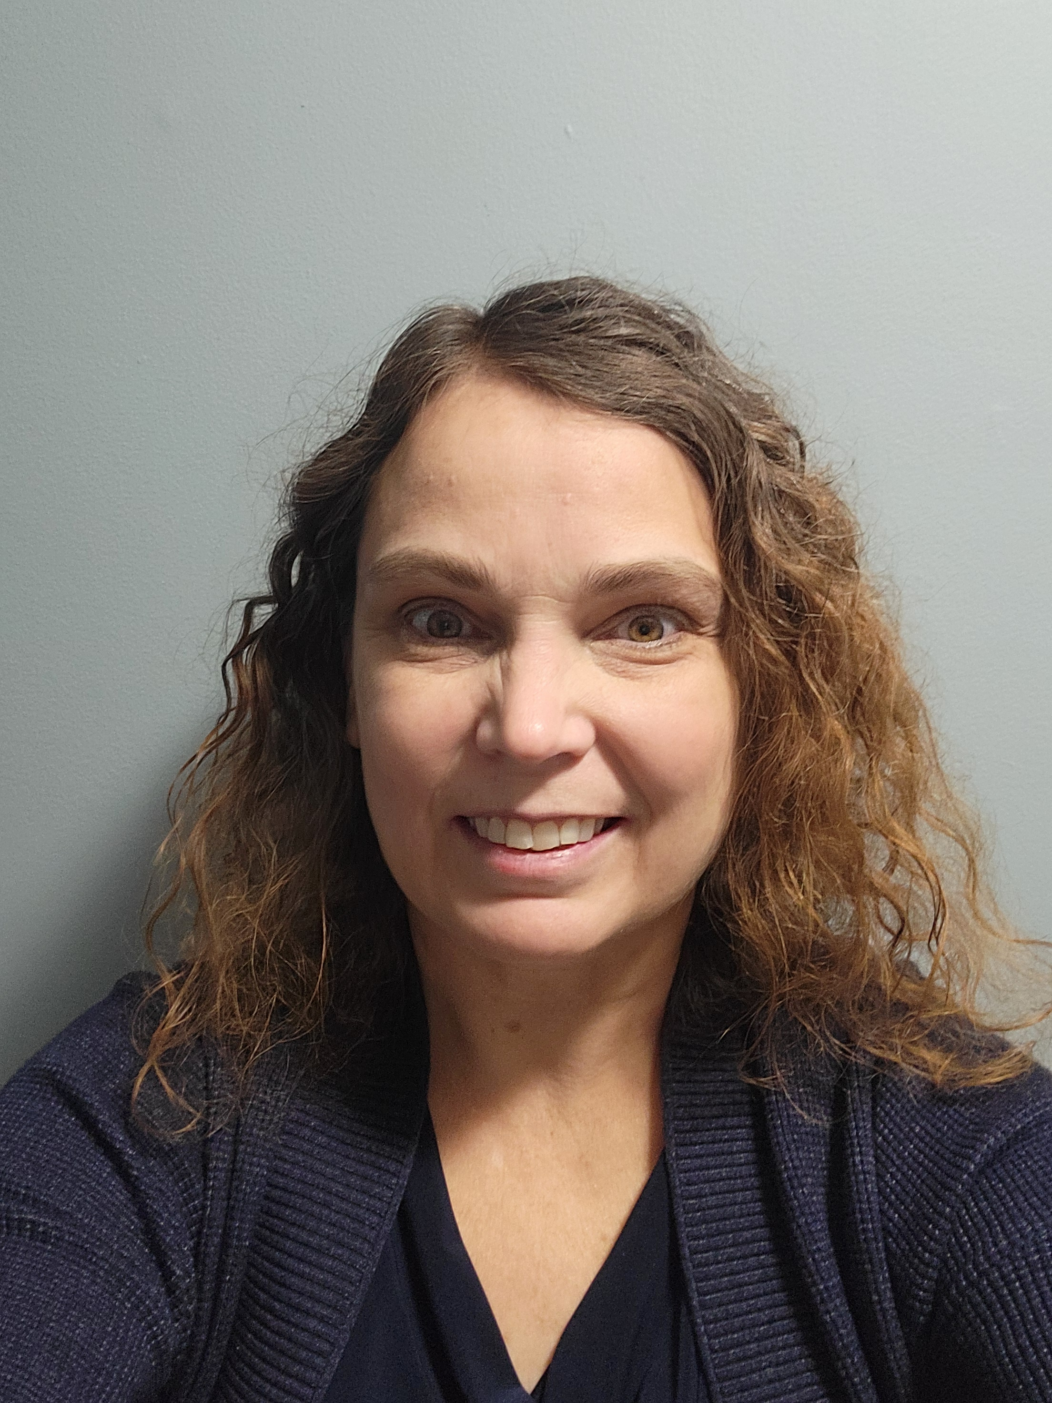
Professional in home and telehealth breastfeeding support
Lactation Home About Me Services FAQs Insurance Contact
Success,
LLC
by Carolyn Mosier
APRN, IBCLC, RLC
Call me for an appointment
(703)599-9180

